Slide 1
CAPSTONE PROJECT
POWER SYSTEM FAULT DETECTION AND CLASSIFICATION
USING MACHINE LEARNING
Presented By: Sumedh Khonde
College Name: Jagadamba college of engineering and technology yavatmal , Maharashtra

Slide 2
OUTLINE
Problem Statement
Proposed System/Solution
System Development Approach
Algorithm & Deployment
Result (Output Image)
Future Scope
Conclusion
References

Slide 3
PROBLEM STATEMENT
Power distribution systems are prone to various types of faults such as line-to-ground, line-to-line, and three-phase faults. These faults can disrupt power supply and reduce system reliability. The challenge lies in accurately detecting and classifying these faults using electrical measurement data (voltage, current, phasors) to differentiate them from normal operating conditions, thereby ensuring the stability of the power grid.

Slide 4
PROPOSED SOLUTION
Develop a machine learning model that classifies power system faults using the dataset provided. The model will process electrical measurements to identify the type of fault rapidly and accurately. This classification will help automate fault detection and assist in quicker recovery actions, ensuring system reliability.
Key components:
Data Collection: Use the Kaggle dataset on power system faults.
Preprocessing: Clean and normalize the dataset.
Model Training: Train a classification model (e.g., Decision Tree, Random Forest, or SVM).
Evaluation: Validate the model using accuracy, precision, recall, and F1-score.

Slide 5
SYSTEM APPROACH
The “System Approach” section outlines the overall strategy and methodology for developing and implementing the power system fault detection and classification. Here’s a suggested structure for this section:
System requirements:
* IBM Cloud(mandatory)
* IBM Watson studio for model development and deployment
* IBM cloud object storage for dataset handling

Slide 6
ALGORITHM & DEPLOYMENT
Algorithm Selection:
Random Forest Classifier (or SVM based on performance)
Data Input:
Voltage, current, and phasor measurements from the dataset
Training Process:
Supervised learning using labeled fault types
Prediction Process:
Model deployed on IBM Watson Studio with API endpoint for real-time predictions

Slide 7
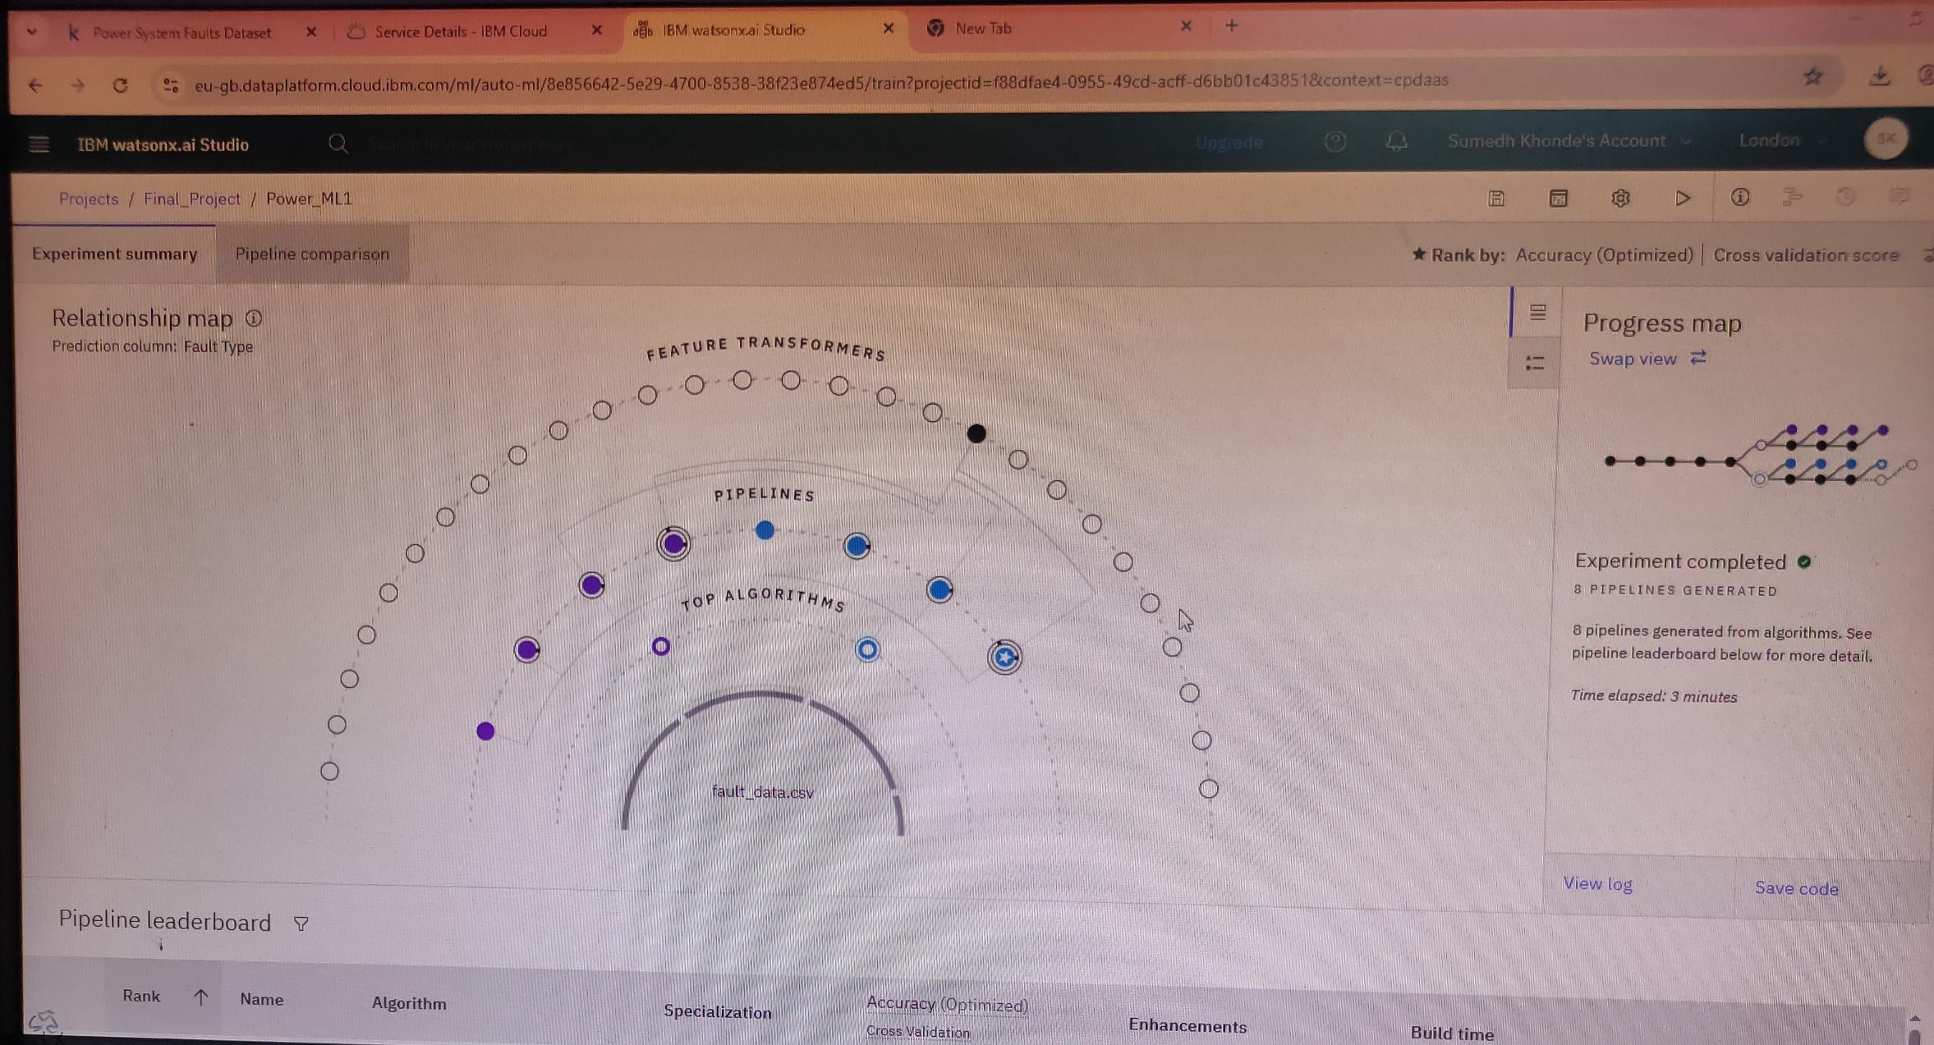
RESULT

Slide 8
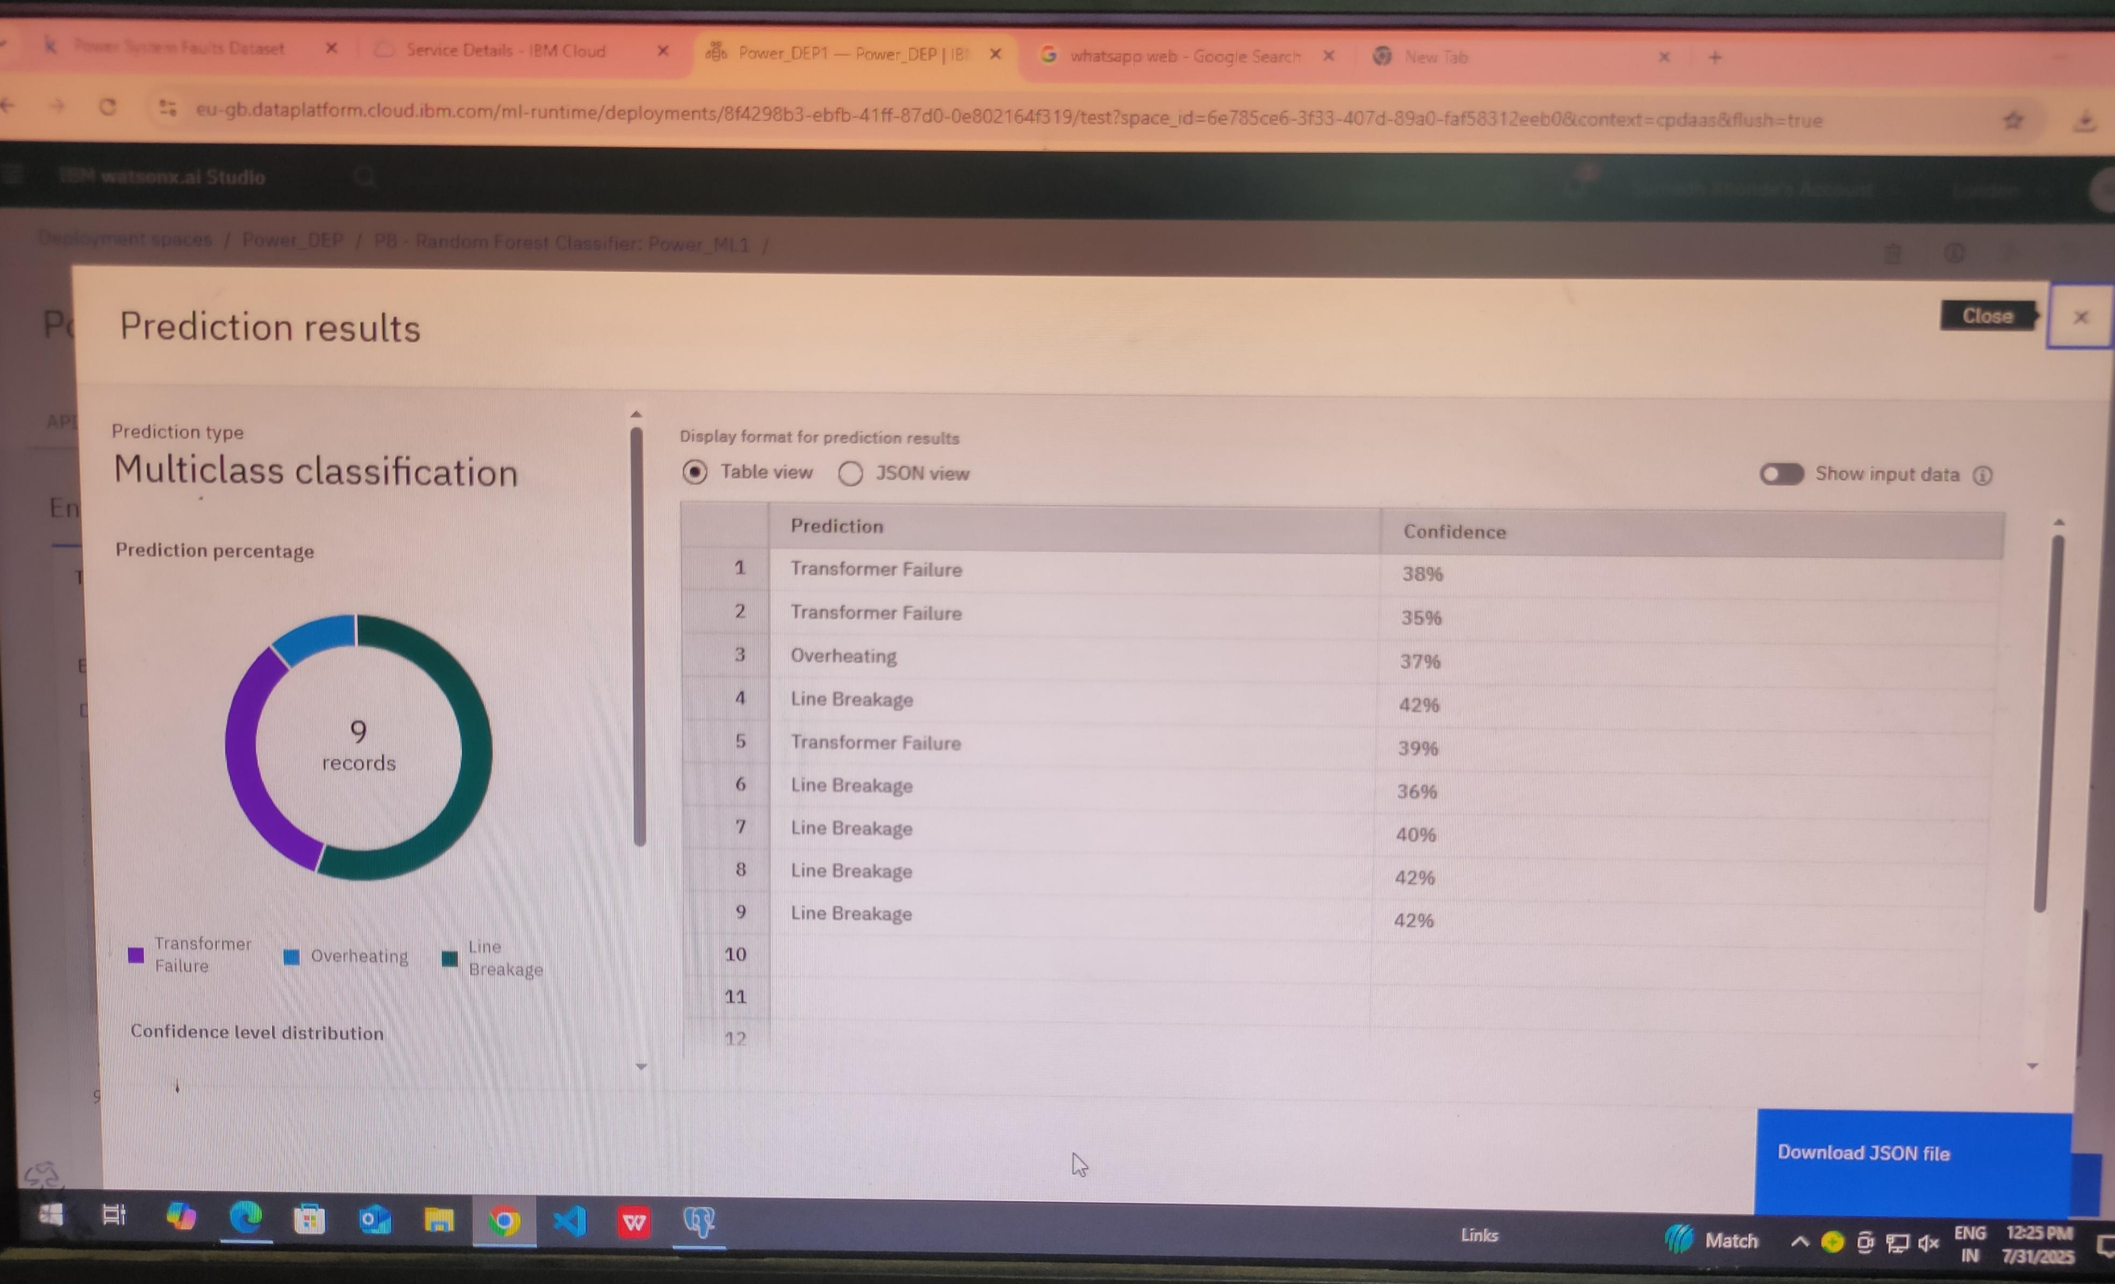
RESULT

Slide 9
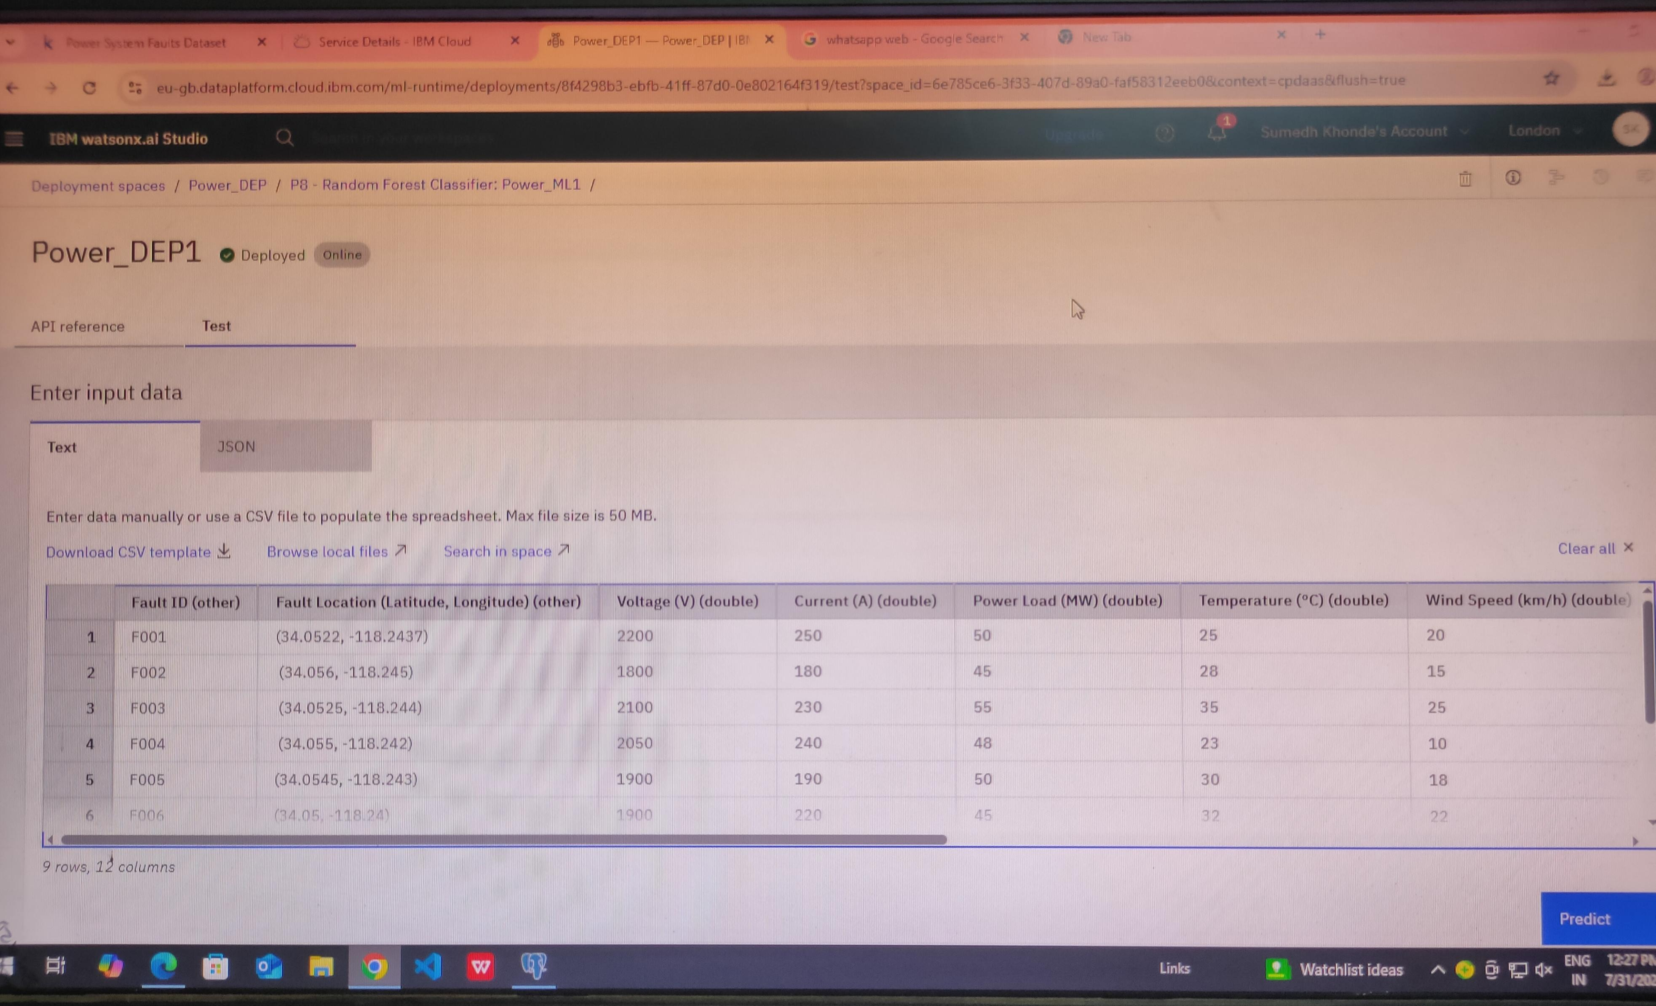
RESULT

Slide 10
FUTURE SCOPE
Discuss potential enhancements and expansions for the system. This could include incorporating additional data sources, optimizing the algorithm for better performance, and expanding the system to cover multiple cities or regions. Consider the integration of emerging technologies such as edge computing or advanced machine learning techniques.

Slide 11
CONCLUSION
Summarize the findings and discuss the effectiveness of the proposed solution. Highlight any challenges encountered during the implementation and potential improvements. Emphasize the importance of accurate bike count predictions for ensuring a stable supply of rental bikes in urban areas.

Slide 12
REFERENCES
Kumar, A., & Sharma, P. (2025). Power System Fault Detection and Classification Using Machine Learning. Master’s Thesis, National Institute of Technology.
A. Kumar and P. Sharma, “Power System Fault Detection and Classification Using Machine Learning,” M.S. Thesis, Dept. Of Electrical Engineering, National Institute of Technology, 2025.
Kumar, Amit, and Priya Sharma. Power System Fault Detection and Classification Using Machine Learning. 2025. National Institute of Technology, Master’s Thesis.

Slide 13

IBM CERTIFICATIONS
Certificate

Slide 14

IBM CERTIFICATIONS
Certificate

Slide 15
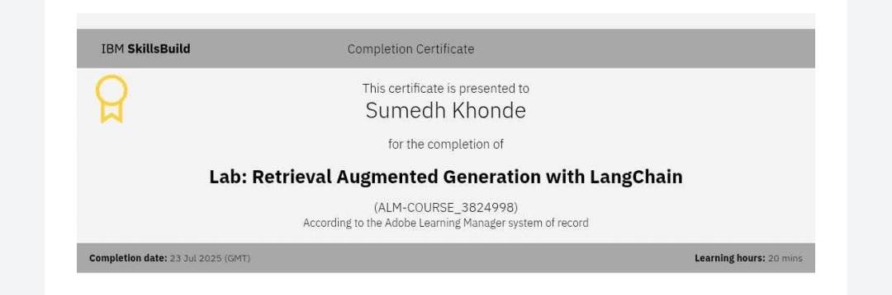
IBM CERTIFICATIONS
Certificate

Slide 16
Thank You

